Slide 1
Breakout Session 2.1 Global and Regional Observation Networks Sustainability and Capacity Building
4th GEOSS Science and Technology Stakeholder Workshop
CONCEPTS, TECHNOLOGIES, SYSTEMS AND USERS OF THE NEXT GEOSS

Slide 2
Questions: Sustaining GEOSS in a Changing World
How important are public-private partnerships for the next GEOSS and who should be involved?
Are there new approach to a sustainable business model for the next GEOSS?
How should a network of networks be governed to ensure sustained observation and processing infrastructure for the next GEOSS?
What can be done to align the next GEOSS better to the needs of the developing world and sustaining capacity in developing economies?
What should the information system of the next GEOSS provide to users and how can we ensure that the system supports those users who are solution-oriented?

Slide 3
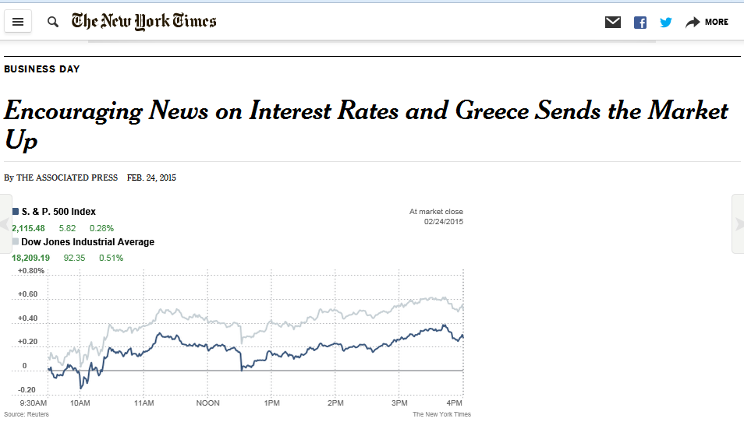
We use economic indicators all the time for decision making!

Slide 4
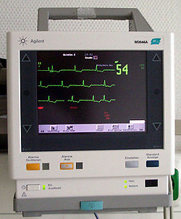
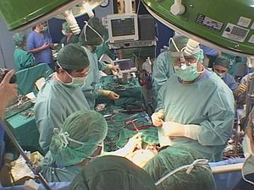
We rely on health indicators to manage our personal health.

Slide 5
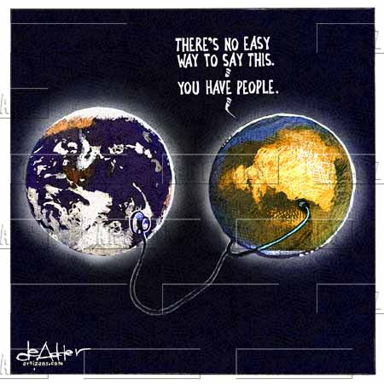
We need good indicators on the status of the Earth and all of its residents!

Slide 6
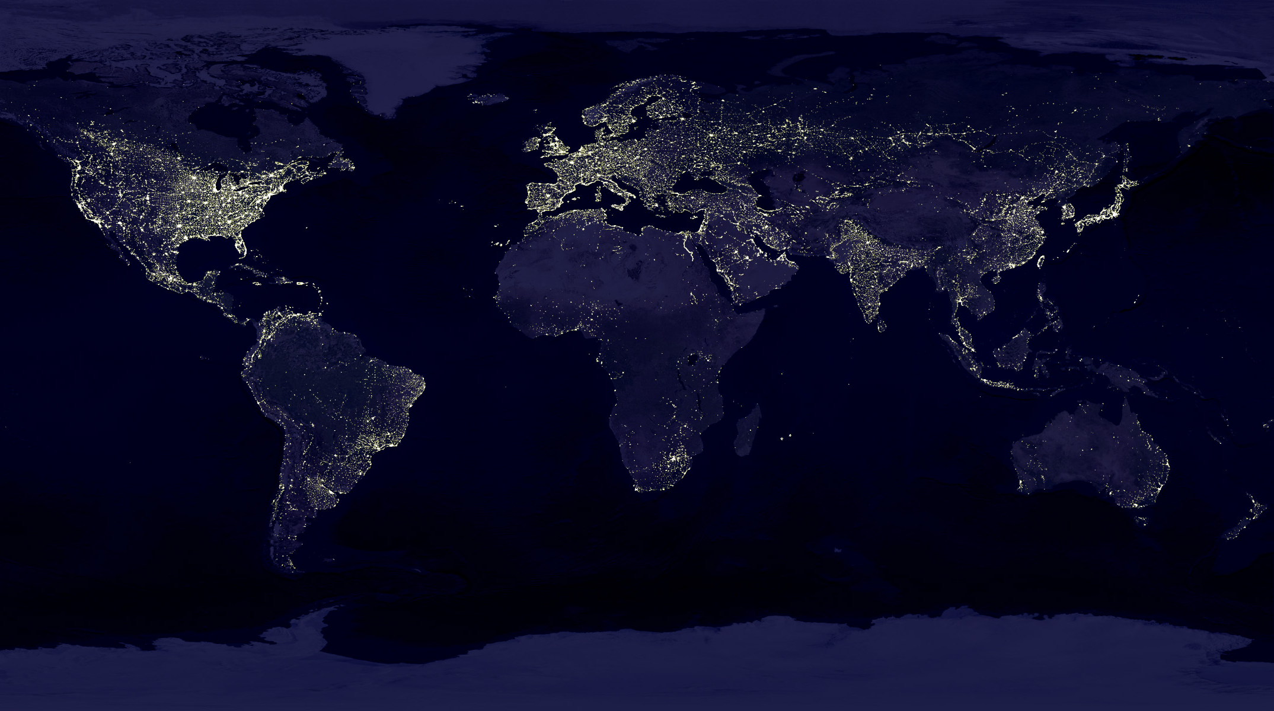
Earth Observations give us the perspectives and detailed data we need for policy-relevant sustainable development indicators.

